Slide 1


ECEN 215 Lab Kit Luis Diaz-Santini, Yusuf Hossain, Ryan Freed, Peter Zhang

Slide 2
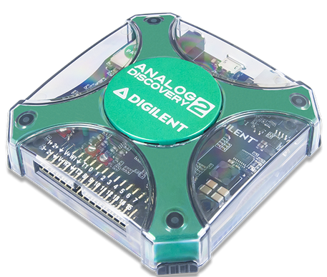
Execute Summary
Problem Statement:
Principles of Electrical Engineering (ECEN 215) teaches the basics of electric circuit analysis and electronics to non-ECEN majors.
The transition of ECEN 215 to an online format poses a challenge due to its lab component relying on the Analog Discovery 2 (AD2), which is expensive.
Solution Proposal:
The ECEN 215 Lab Kit offers a solution to the cost, convenience, and over complication issues that are abundant with the AD2. Aiming for a $50 price point, the lab kit offers a more catered simpler approach to each lab while also making it possible to complete at home.
Will operate as the power supply, signal generator, multimeter, and Oscilloscope.

Slide 3
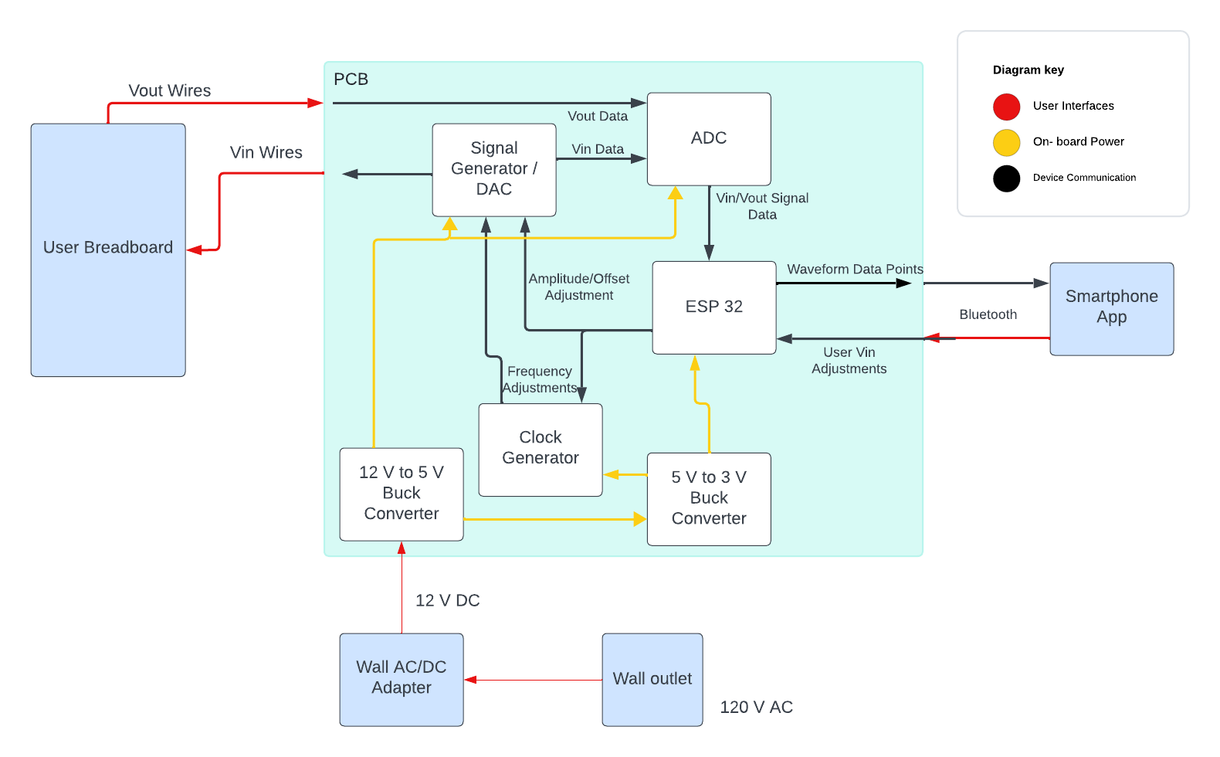
Subsystems & Block Diagram
Peter:
Multimeter and Oscilloscope
Yusuf:
Waveforms and communicating to the microcontroller.
Luis:
Create mobile application to interface with device
Ryan:
PCB design and power.

Slide 4
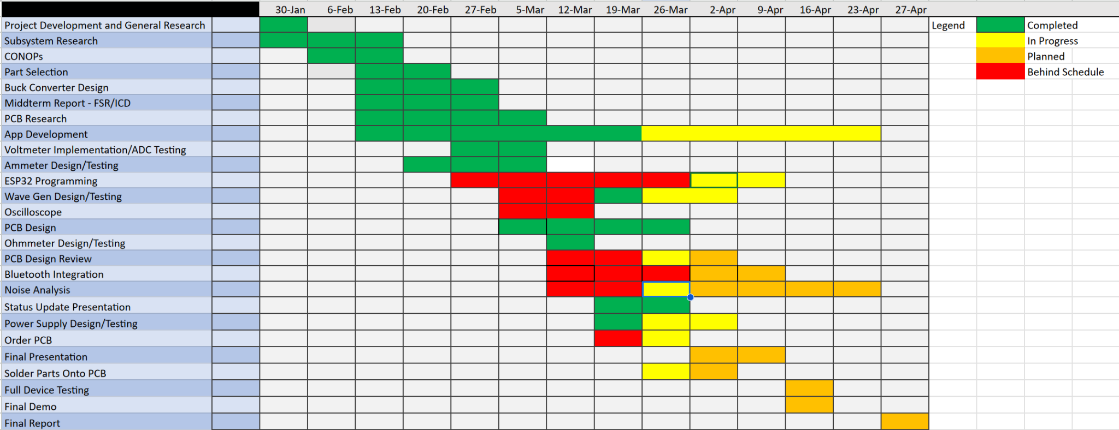
Execution plan

Slide 5
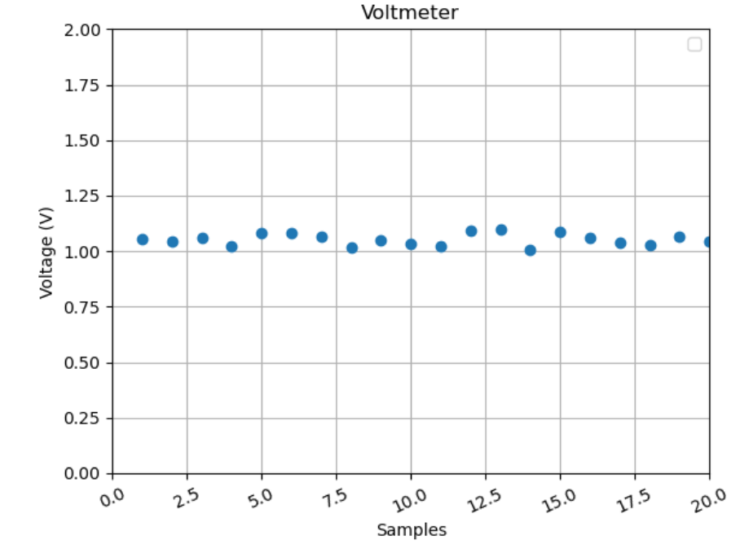
Oscilloscope & Multimeter Subsystem
Peter Zhang
Accomplishments since the last presentation <27> hrs | Ongoing progress/problems and plans until the next presentation
Designed and tested the ammeter, ohmmeter, and voltmeter. Developed the oscilloscope. | Noise analysis. Bluetooth Integration. Oscilloscope testing.

Slide 6
Waveform Generator &
Microcontroller Subsystem
Yusuf Hossain
Accomplishments since the last presentation <15> hrs | Ongoing progress/problems and plans until the next presentation
Generated Sin and Square Waveforms Made adjustable Frequency using potentiometer | Generate Triangle Waveform Figure out how to communicate with app to receive inputs Changing Amplitude

Slide 7
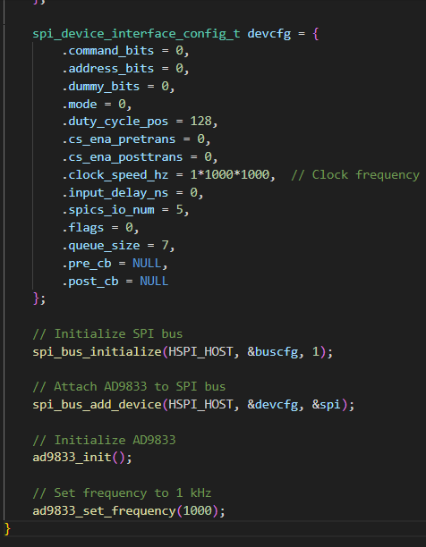
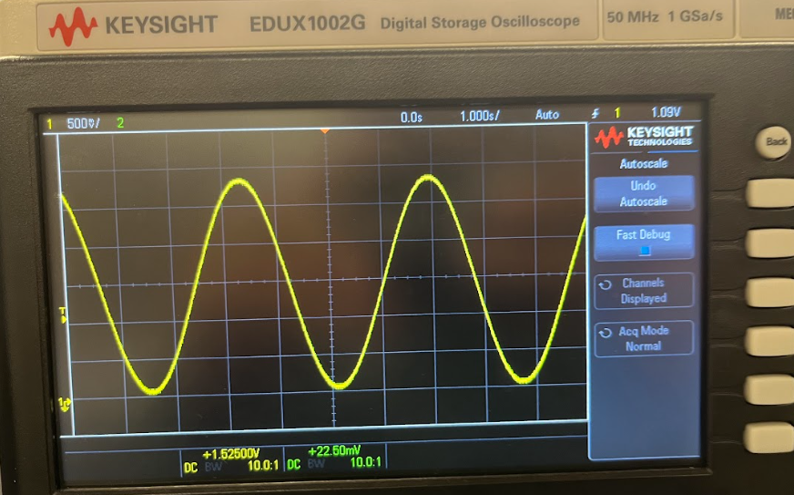
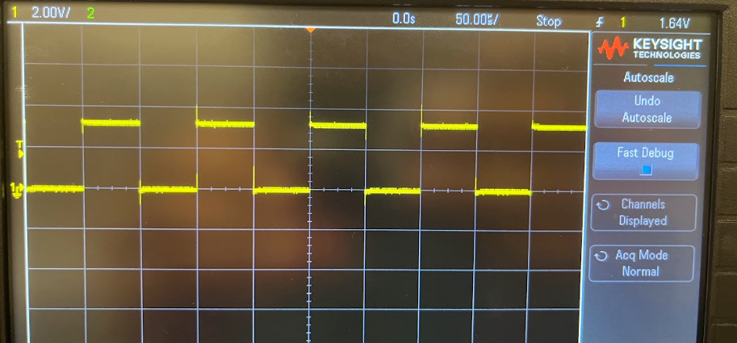

Slide 8
Board Layout Subsystem
Ryan Freed
Accomplishments since the last presentation 39 hrs | Ongoing progress/problems and plans until the next presentation
Designed PCB schematic and board design, completed component selection, reduced board size to 150x100mm (Task Breakdown: PCB schematic draft 1 - 10 hrs, draft 2 - 6 hrs, Power Supply design - 5 hrs, Part Selection - 7 hrs, Board design - 10 hrs) | Order PCB, solder on components, test board functionality, reduce any signal noise

Slide 9
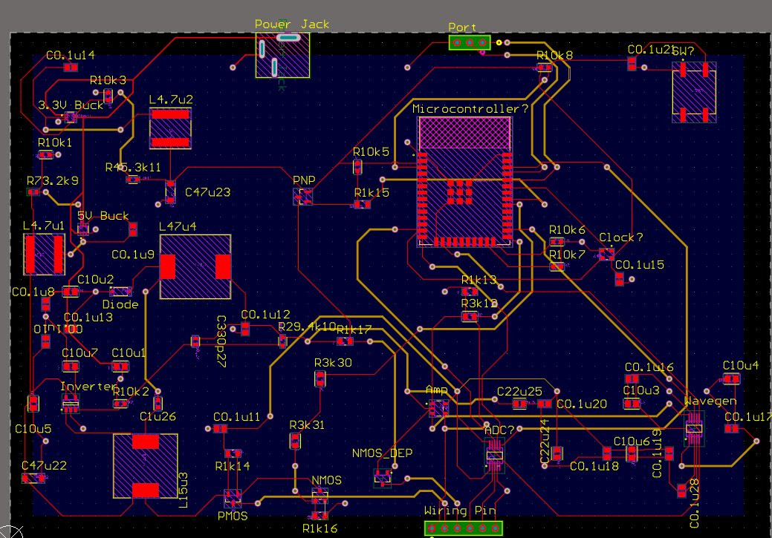

Slide 10
Software Subsystem
Luis Diaz-Santini
Accomplishments since the last presentation 35 hrs | Ongoing progress/problems and plans until the next presentation
Setup Android phone emulator and Flutter environment through VSCode. Finalized concept pages for application and custom bluetooth actions that the app will utilize. Began coding/implementing custom action functionality within pages. | Continuing to debug custom Bluetooth actions and begin testing integration. Bluetooth plugin might not support emulation.

Slide 11
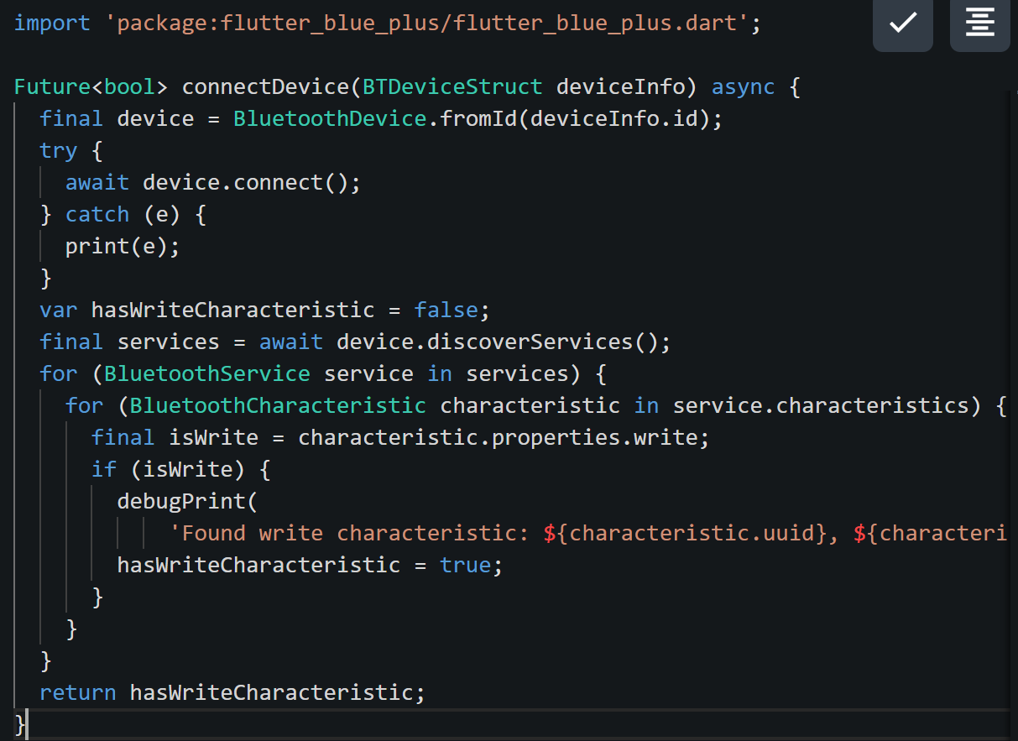
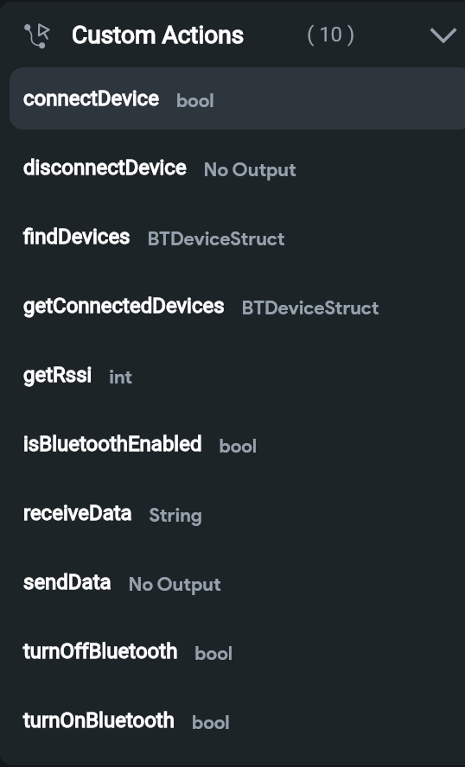
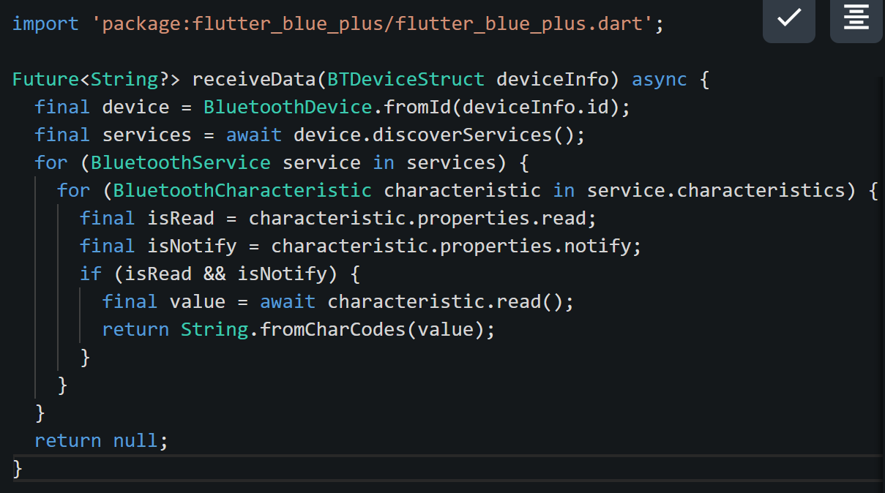

Slide 12
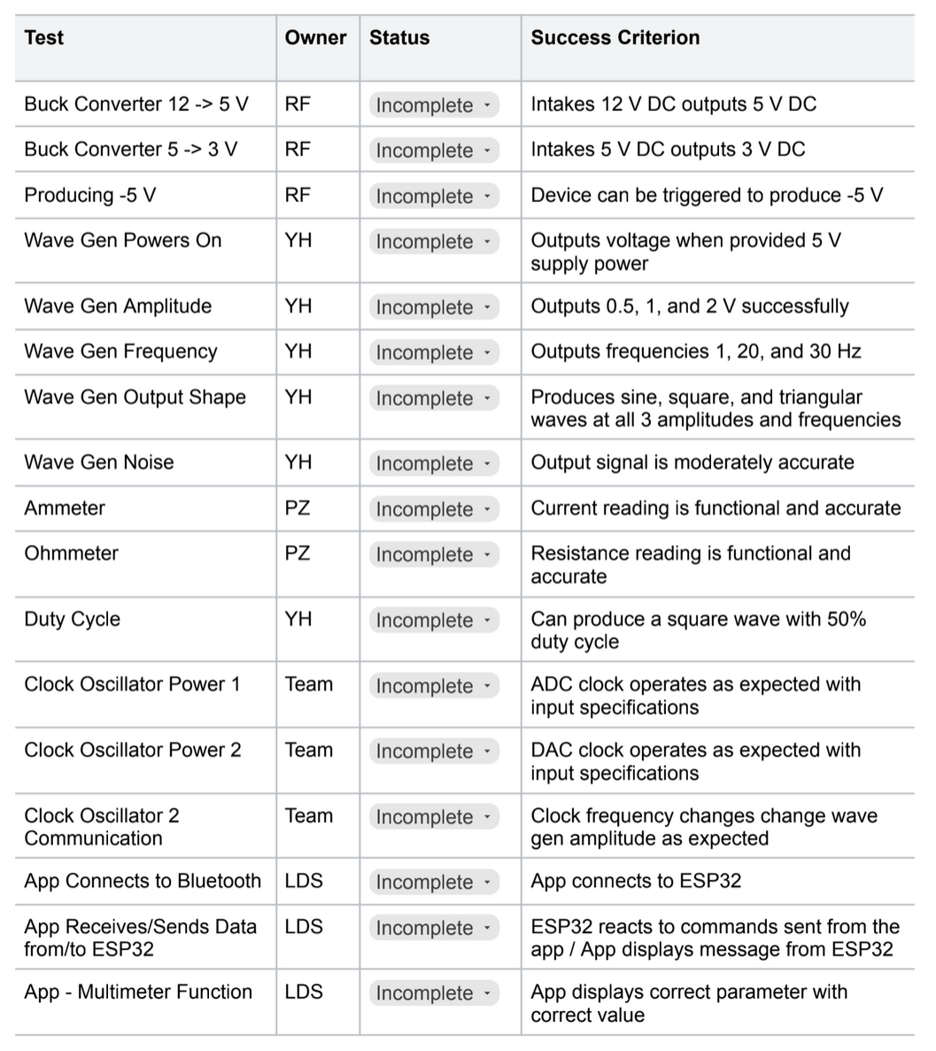
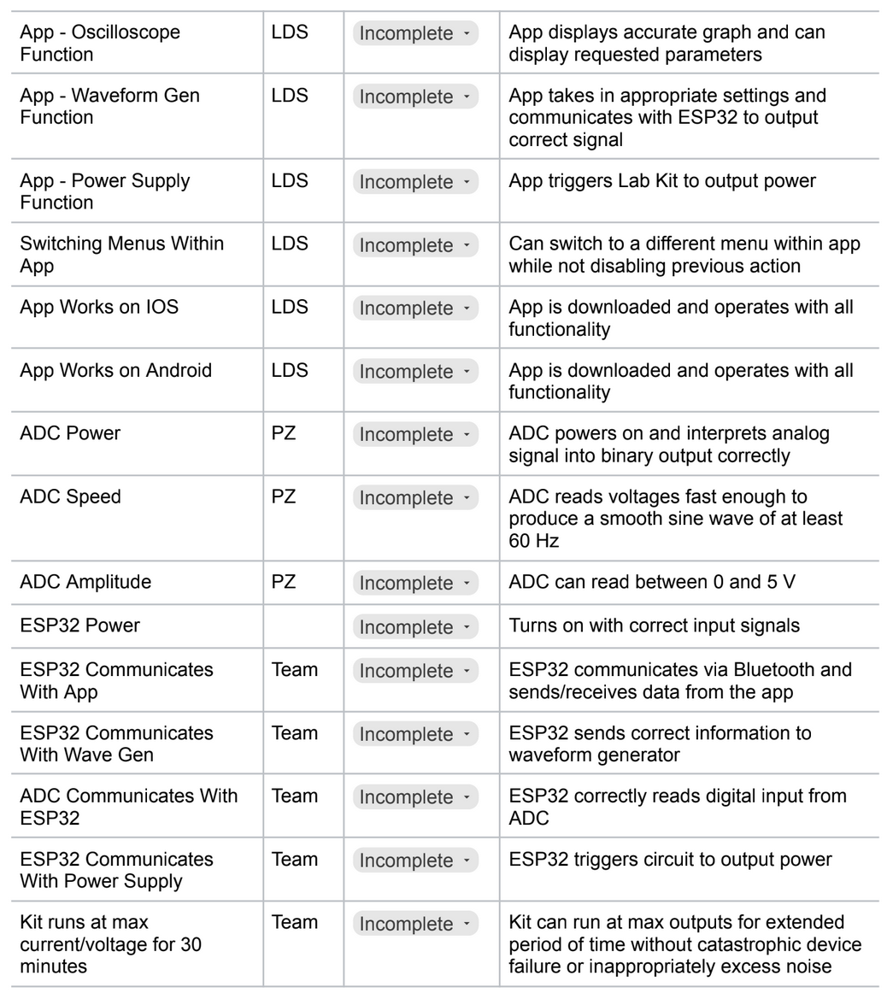
Validation plan

